Slide 1

OUR ENVIRONMENT
Formation of Ozone, Ozone Layer, Waste Material Management

Slide 2


Formation Of Ozone In Stratosphere
Ozone (O₃) is a molecule formed by three atoms of oxygen.
O
O₂
O₃

Slide 3

While O₂, which we normally refer to as oxygen, is essential for all aerobic forms of life.
Ozone, is a deadly poison.

Slide 4
However, at the higher levels of the atmosphere, ozone performs an essential function.

Slide 5


It shields the surface of the earth from ultraviolet (UV) radiation from the Sun.
SUN
Stratosphere-second layer of atmosphere 48 km-ozone.
STRATOSPHERE
EARTH
ATMOSPHERE

Slide 6
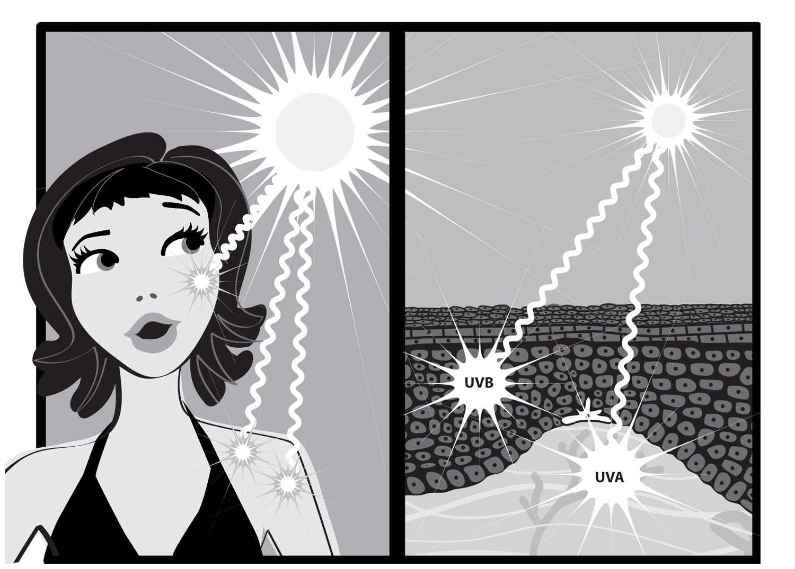
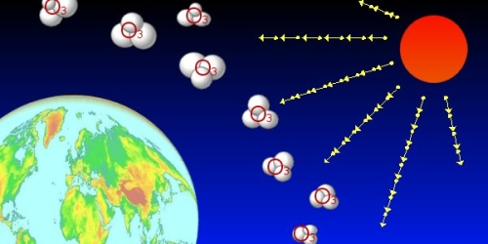

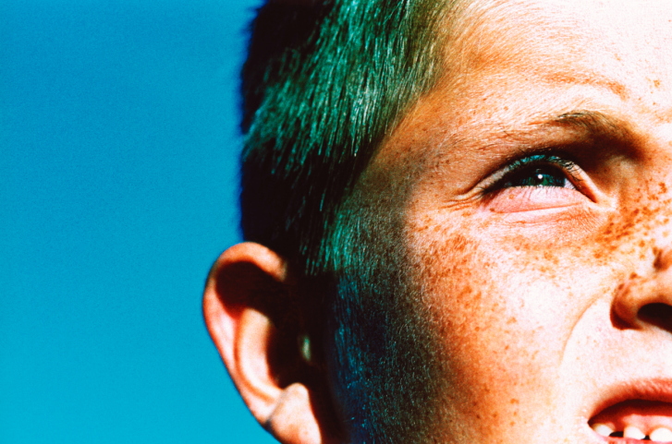

This radiation is highly damaging to organisms, for example, it is known to cause skin cancer in human beings.
Ozone absorbs harmful UV rays from the sun.
Protects plant and animals.

Slide 7

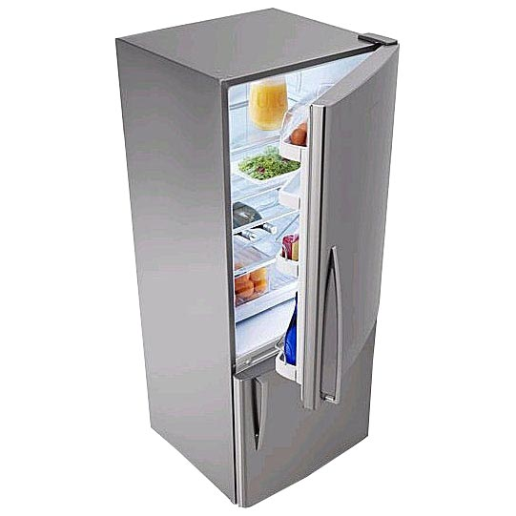
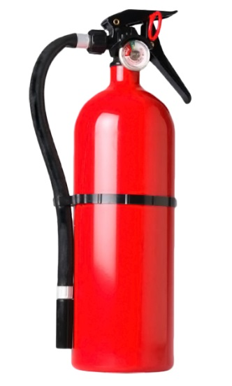
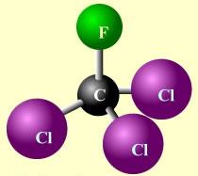
The amount of ozone in the atmosphere began to drop sharply in the 1980s.
This decrease has been linked to synthetic chemicals like chlorofluorocarbons (CFCs)
Which are used as refrigerants and in fire extinguishers.

Slide 8

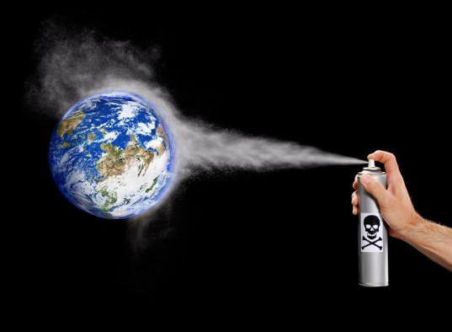
In 1987, the United Nations Environment Programme
(UNEP) succeeded in forging an agreement to freeze CFC production at 1986 levels.

Slide 9

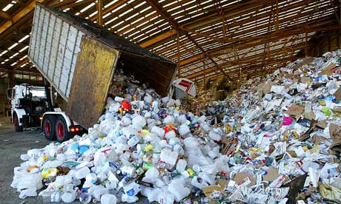
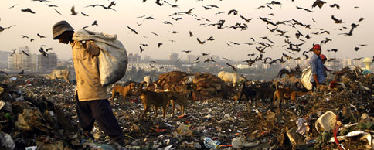
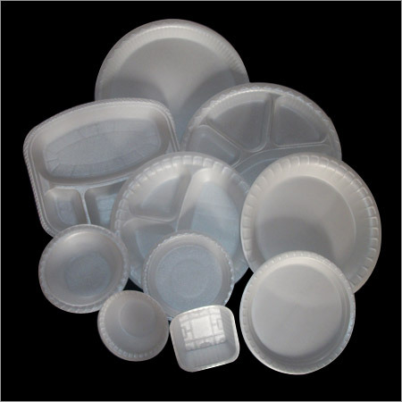
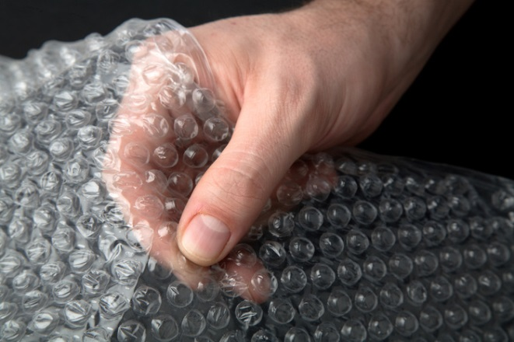
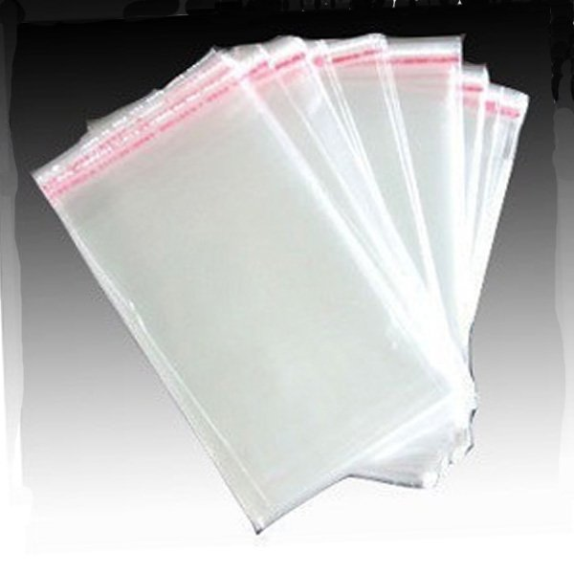
Managing the Garbage we Produce
Improvements in our life-style have resulted in greater amounts of waste material generation.
Changes in attitude also have a role to play, with more and more things we use becoming disposable.
Changes in packaging have resulted in much of our waste becoming non-biodegradable.

Slide 10
Thank You

